Slide 1
Team Velocity

Slide 2
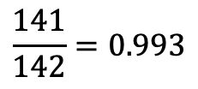

Completed/Committed Ratio
$$Completed/Committed Ratio$$
$$\frac{141}{142}=0.993$$

Slide 3
Burndown Charts

